Slide 1
Lindenwood Elementary School Title I Program/Family Engagement
9/13/23 Title 1 Meeting
Presented by:
Nancy Whitaker, Family Engagement Spec.
Brienne Hunt, Title 1 Teacher

Slide 2
Purpose Of This Presentation:
To provide information to families regarding Title I
Explain Families' Rights Under Title I
Introduce Lindenwood's Title I Staff

Slide 3
What is Title I?
TITLE I, PART A IS THE FUNDING SOURCE UNDER ESEA THAT PROVIDES ASSISTANCE TO STATES AND SCHOOL DISTRICTS TO MEET THE NEEDS OF EDUCATIONALLY AT-RISK STUDENTS.
THE GOAL OF TITLE I IS TO PROVIDE EXTRA INSTRUCTIONAL SERVICES AND ACTIVITIES THAT SUPPORT STUDENTS IDENTIFIED AS FAILING OR MOST AT RISK OF FAILING THE STATE'S CHALLENGING PERFORMANCE STANDARDS

Slide 4
What is ESEA?
IN 1965, PRESIDENT LYNDON B. JOHNSON PASSED THE ELEMENTARY AND SECONDARY EDUCATION ACT (ESEA) AS A PART OF THE "WAR ON POVERTY." ESEA EMPHASIZES EQUAL ACCESS TO EDUCATION AND ESTABLISHES HIGH STANDARDS AND ACCOUNTABILITY.
THE LAW AUTHORIZES FEDERALLY FUNDED EDUCATION PROGRAMS THAT IMPROVE LEARNING OPPORTUNITIES FOR CHILDREN AT RISK.
IN 2015, CONGRESS AMENDED ESEA AND PASSED IT AS A NEW LAW, THE EVERY STUDENT SUCCEEDS ACT (ESSA)

Slide 5
Parent's Right To Know
You have the right to ask about the qualifications of the staff working with your child.
You have the right to receive your child's SOL test scores.
You have the right to be notified if your child's class has been taught for more than four consecutive weeks by a teacher not endorsed or licensed for that subject area or grade level.

Slide 6
How Can Funds Be Used?
ACADEMIC INTERVENTION PROGRAMS FOR STRUGGLING STUDENTS
PROFESSIONAL DEVELOPMENT FOR TEACHERS AND STAFF
FUNDING FOR INSTRUCTIONAL MATERIALS/SUPPLIES
FAMILY ENGAGEMENT ACTIVITIES
ACADEMIC FIELD TRIPS
FUNDS FOR THE HIRING OF ADDITIONAL STAFF TO ASSIST IN THE INSTRUCTIONAL PROGRAM OF THE SCHOOL EACH TITLE I SCHOOL USES FUNDS ACCORDING TO A NEEDS ASSESSMENT THAT IS COMPLETED EACH YEAR

Slide 7
Introducing Lindenwood Title I Staff
Nancy Whitaker, Family Engagement Specialist
Brienne Hunt, Title 1 Teacher
Reginald Freeman, Title 1 Paraprofessional

Slide 8
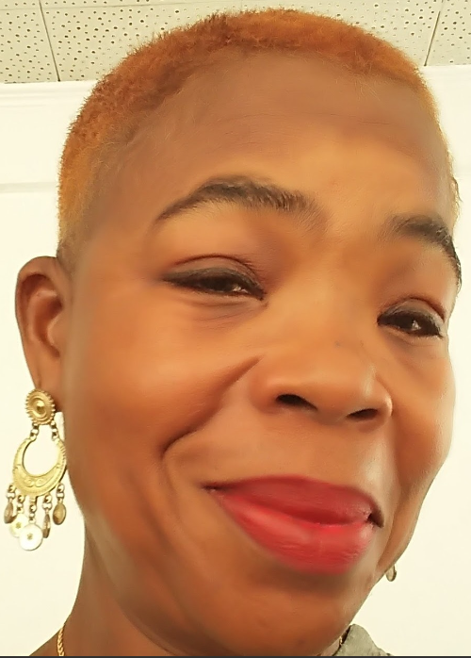
Family Engagement Specialist
Nancy Whitaker
Nwhitaker@nps.k12.va.us

Slide 9
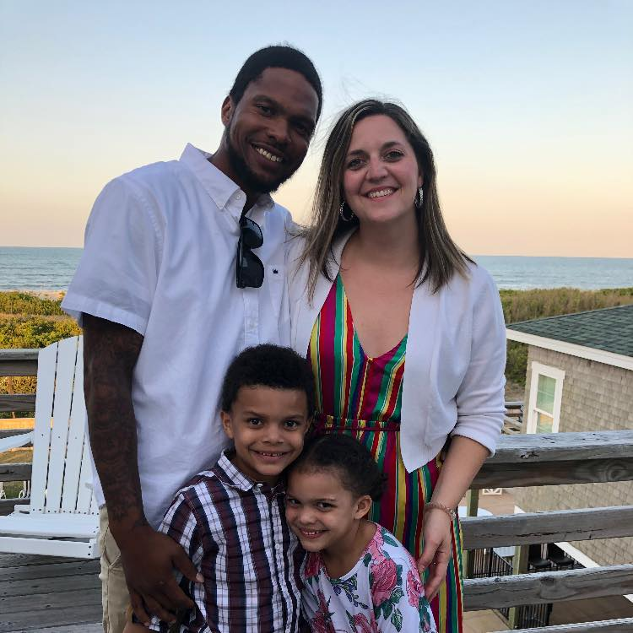
Title 1 Teacher
Brienne Hunt
bhunt876@nps.k12.va.us

